Slide 1
Bio-medical Image Processing
Dr. R. Devika Rubi

Slide 2
Objective of Biomedical Informatics
"Biomedical Informatics (BMI) is a discipline that has been defined as the study, invention, and implementation of structures and algorithms for the manipulation of medical/ clinical data and to improve communication, understanding and management of medical information”
It is about working on the data (Text and Imaging) obtained from the Patients directly and trying to improve the Healthcare system and better decision making system
Try to improve the decision making process for a specific therapy or treatment
It is in demand because the level of automation and better diagnostic systems are increasing

Slide 3
Biomedical Informatics in Perspective
Biomedical Informatics Methods, Techniques, and Theories
Basic Research
Biomedical Informatics ≠ ≠ Bioinformatics
Applied Research
And Practice
Imaging Informatics
Clinical
Informatics
Public Health Informatics
Bioinformatics

Slide 4
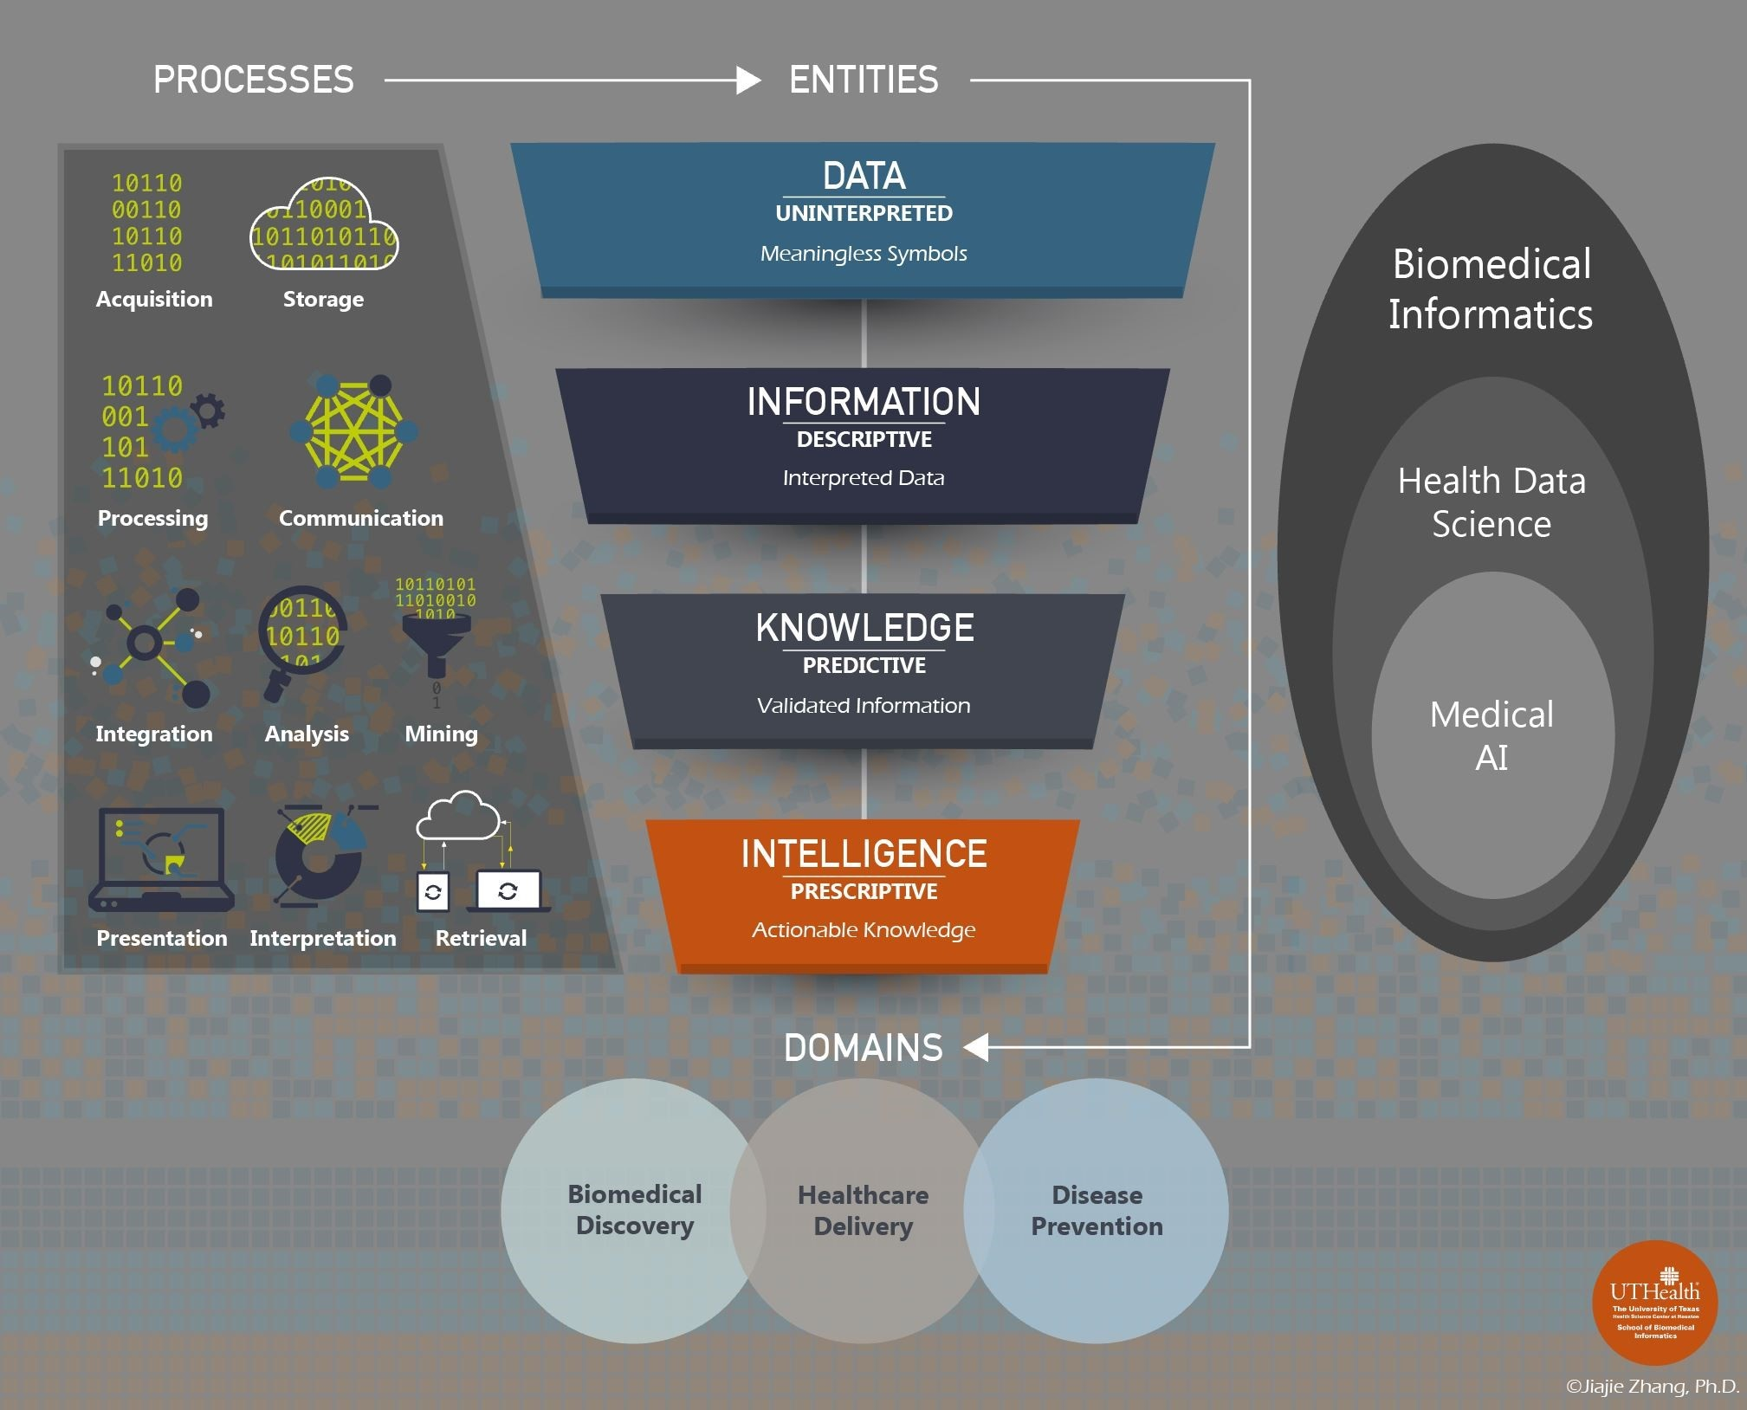
Biomedical Informatics = Health Data Science + Medical AI

Slide 5
BMI – Data Science Framework
Data is unintepreted, unprocessed, meaningless raw symbols, signals or pixels.
For example, “101” could mean several things; the decimal number one hundred and one, the binary number five, the values of three pixels or even a label for a highway. Without context, most data types are meaningless
Information is interpreted data or data with meaning.
- For example, once we know that the metric for 101 is degrees in Fahrenheit, we immediate correlate the number to temperature
- Information provides a descriptive function and tells you what happened, at what juncture and for whom
Knowledge is organized information that is justified or validated
- For Eg. 101 °F is an adult oral temperature. Indicates an abnormal body status (fever) and this relation is validated in medical practice and research. Knowledge provides a predictive function and tells you what might happen. An adult oral temperature of 101 °F predicts that the body status is irregular.
Intelligence is actionable knowledge
- For Eg. An adult with a 101°F temperature should take fever medication, have further assessment and diagnosis performed and may need to see a doctor if it is not a simple cold
- Intelligence provides prescriptive function and tells you what needs to be done

Slide 6
Biomedical Informatics Career, Jobs
Patient records were once stored in paper files. Now, with new laws making electronic storage of records mandatory, there is a huge need for health informatics specialists who are highly trained in the practice of acquiring, maintaining, and protecting of digital data.
Since new health information management programs are being developed on a regular basis, it is imperative that doctor offices, clinics, medical schools, and hospitals all have their own informatics specialists who can keep information systems up and run efficiently
It is the health information manager who helps keep clinical, operational and administrative departments connected
According to the U.S. Bureau of Labor Statistics, projects that employment in health informatics and related fields will grow nearly 17% from 2014-2024, much faster than average for all professions

Slide 7
Top 4 Technologies/Research in Digital Medical Imaging
ARTIFICIAL INTELLIGENCE (AI)
The doctor will be guided by AI on the best imaging test to be conducted on the patient (based on symptoms)
On how best to position for the machine, preparing the right settings for the scan (based on age, gender, area or disease of focus, etc.)
AI will allow for using lower doses of radiation to produce somewhat low-quality images and then transform them into high-quality ones, making use of raw data from the machines
Augmented reality (AR) and virtual reality (VR)
With AR, medical images can be converted and mounted on AR headsets that the surgeon can wear while performing the surgery facilitating better visualization of the patient anatomy
An example of an AR-based pre-surgical planning solution is Novarad’s OpenSight AR system, U.S. Food and Drug Administration (FDA)-approved
3D Printing
AR models and 3-D printed models were much more effective at helping patients understand their anatomy, (Eg.kidney or prostate tumor’s specific details), thus helping them become more confident and secure in making the right surgical choices
CINEMATIC RENDERING AND DIGITAL TWIN TECHNOLOGY
3-D images can be combined with additional information to feed into cinematic rendering tools, provides realistic visualization of the complex organ (eg. Heart) functions that can help surgeons with planning procedures, explaining medical procedures to patients and to help better diagnose disorders
the data specific to a patient might be built into a “digital twin,” (virtual replicas of data) which could serve as a patient simulator for testing the effectiveness and safety of different treatments before deciding finally on one to prescribe

Slide 8
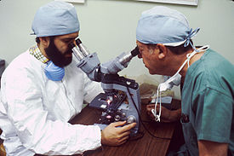
Pathology
Pathology is the study of the causes and effects of disease or injury
An area which includes a number of distinct but inter-related medical specialties that diagnose disease, mostly through analysis of tissue, cell, and body fluid samples
A pathologist examines a tissue section for evidence of cancerous cells while a surgeon observes

Slide 9
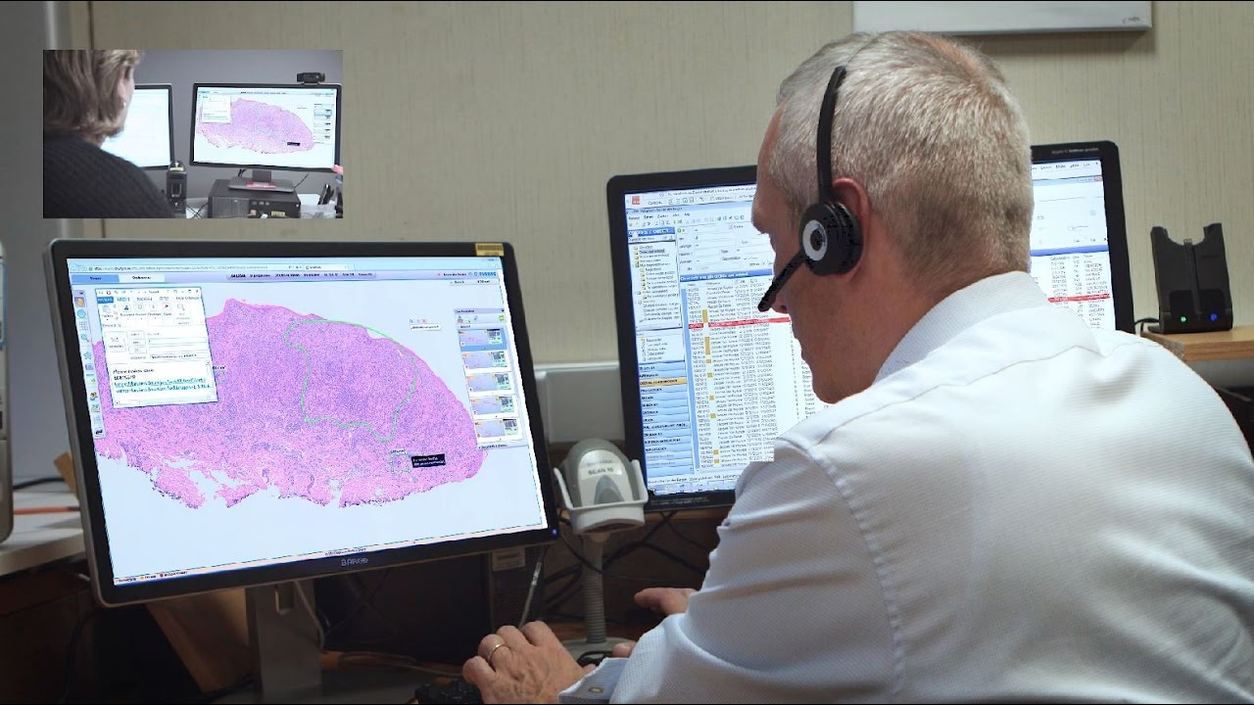
Digital Pathology
The diagnosis of cancers in modern medicine typically involves a biopsy of the tissue in question, specimens have been sectioned and placed onto glass slides followed by visual microscopic examination by a licensed pathologist
Digital pathology is a dynamic, image-based environment that enables the acquisition, management and interpretation of pathology information generated from a digitized glass slide (WSI-Whole Slide Image – SVS files into >1 GB)

Slide 10
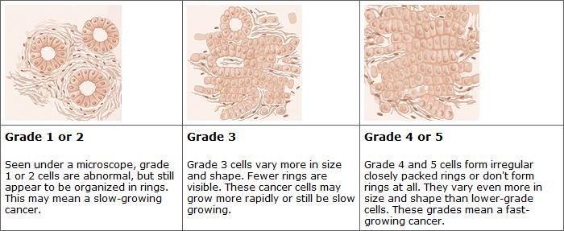
Cancer Grading

Slide 11

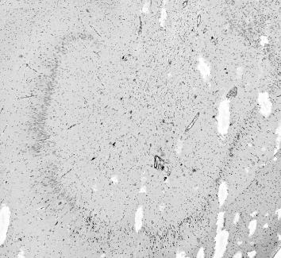
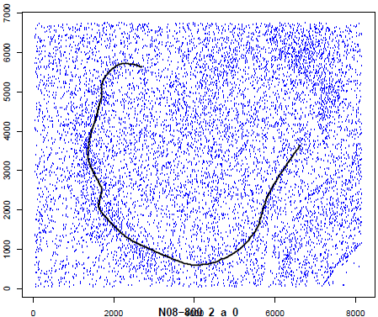
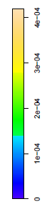
Computer Vision Tasks in Pathology
Nuclei Detection
and Classification
Sub-cellular level
Segmentation
Structure Estimation
Morphology

Slide 12
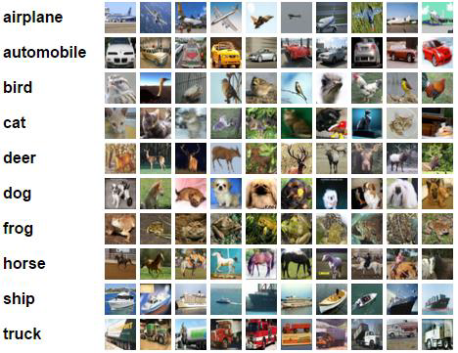
Dataset Sizes: Computer Vision vs. Computational Pathology
1 Whole Slide = 100,000 x 60,000 = 6 billion pixels
CIFAR-10 (32*32)*60K= 61.44 million pixels
All 60,000 CIFAR images fit into this box

Slide 13
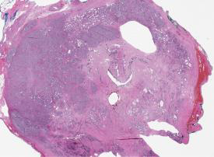
Dataset Sizes: Computer Vision vs. Computational Pathology
All of ImageNet
482 x 415 * 14,197,122
= 2.8 trillion pixels
n=1
n=474
474 Whole Slides
100,000 x 60,000 *474
=2.8 trillion pixels

Slide 14
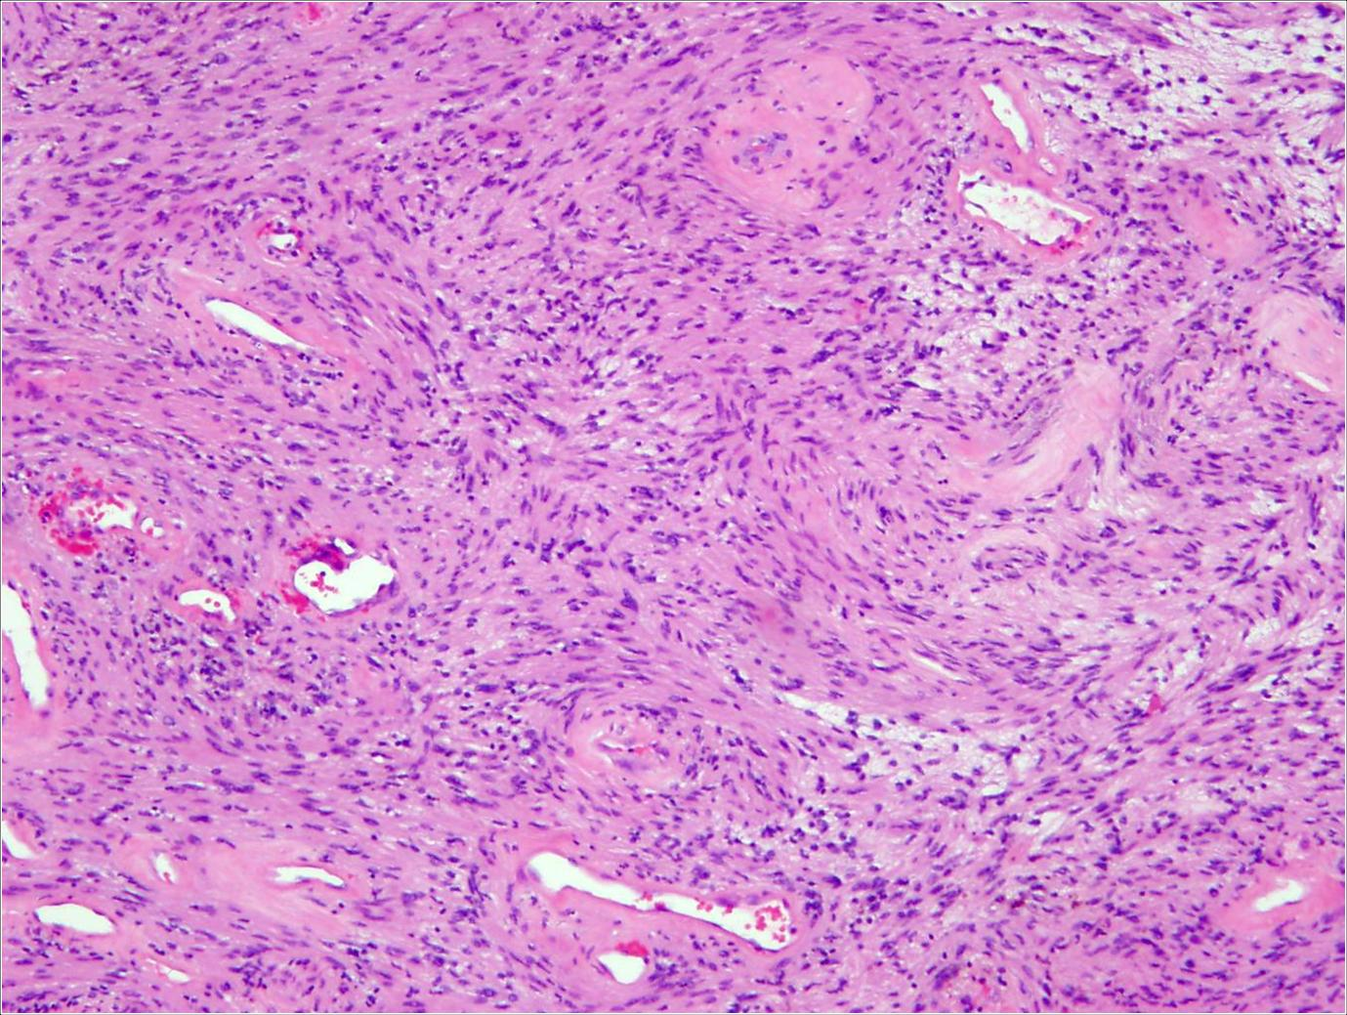
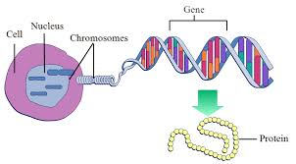
Pathology and Genomics

Slide 15
KMIT BMI : Education and Research

Slide 16
KMIT – BMI Education & Research
The primary aim and motivation of higher education should be facilitating and inducing interest, awareness to the learners that “Science is for common man; that they should apply whatever they learn, research, into practical application development for finding out solutions to common/societal problems”.
In line with the above theme, our Lab Vision is “A good biomedical informatics education, research is for Cure, Prevention of disease growth, design and development of affordable drugs indigenously and cost-effective health care for a billion population”.

Slide 17
CADS-C : Computed Assisted Diagnostic System for Cancer
CCADS-C DB
(Images, Clinical data)
TCGA, cBioPortal
CADS-C (Computer Aided Diagnostic System for Cancer disease)
Web Interface
Physician Assisted Tools
1.Pathology Report
2. Ground Truth Annotation Tool
3.Automated Analysis and diagnose of the disease by using collected annotated images and CNN
4. Any other tools
Uni-Cancer Grading using ML
Tiles Extraction from WSI Pipeline
Coarse Features Extraction for all tiles (Statistical 1st Order)
Dimensionality Reduction and Clustering
Multi-Cancer Classification using CNN
1.AlexNet
2.Inception
3.VGG16
4.CaffeNet
5. Customized
Identify the local representative of each clusters
Extraction of RoI for local representative (Statistical 2nd Order)
3. Identify Disease Structural Features (Eg.:Nuclei, Storma, Lymphocytes,
TIL, RBC, WBC identification/segmentation, Mitosis Count) using ML
4. Identify specific components for respective cancer
(For Eg. Vascular Thrombosis 2. Microvascular
Proliferation (MVP) 3. Pseudopallisading Necrosis
for GBM grading)
5. Grading/Classification of disease using extracted features
Integrating Image Features and the Molecular characteristics/expression
For identified/diseased RoI/Tissue
6. Tumor Microenvironment (Angiogensis, Hypoxia & molecular correlates)

Slide 18
CADS-C : Computed Assisted Diagnostic System for Cancer
CADS-C is an automated computer aided disease diagnostic, progression and prediction system for Cancer Disease
A web-based informatics platform integrated with an information management system to manage whole slide images (WSI) and human expert annotations as ground truth
This platform facilitates, helps physicians, hospitals to improve clinical care to cancer patients
It will have an interactive, user-friendly, UI to Manage various data/details of entire disease eco-system like Images (Pathology, radiology, MRI/CT scans etc, starting with pathology WSI slides), patients, hospitals, clinical, physicians etc.
Will have
Physicians assisted tools (like Pathology Report, Disease grade/type, pathologists/physician’s annotation tool for ground truth, Automated Annotation development capabilities using CNN
Quantitative Machine Learning features from WSI images
Automating various Digital Pathology Tasks like Lymphocytes/Mitosis detection, WBC/RBC detection/count, Pseudopalisading Necrosis detection on Glioma Images etc)
Bio-med Research pipeline tools (like Multi-cancer classification pipeline, Uni-cancer grading tool, Disease Associated Genomic data pipeline, Disease morphological characteristics association with base genome etc)

Slide 19
Technologies Required for CADS-C
Familiarity with Various Biomedical Images – Radiology (MRI, CT Scan, Mammogram, X-Rays etc Pathology (Digitized Tissue Slides)
Digital Image Processing techniques (Image Enhancement, Convolution, Image Restoration, Segmentation and Features Extraction)
Various Machine Learning Techniques
Deep Learning - Various Convolutional Neural Networks (CNN)
Programming languages – Python, C++, Matlab
Computer Vision Tools – Scikit-image, OpenCV

Slide 20
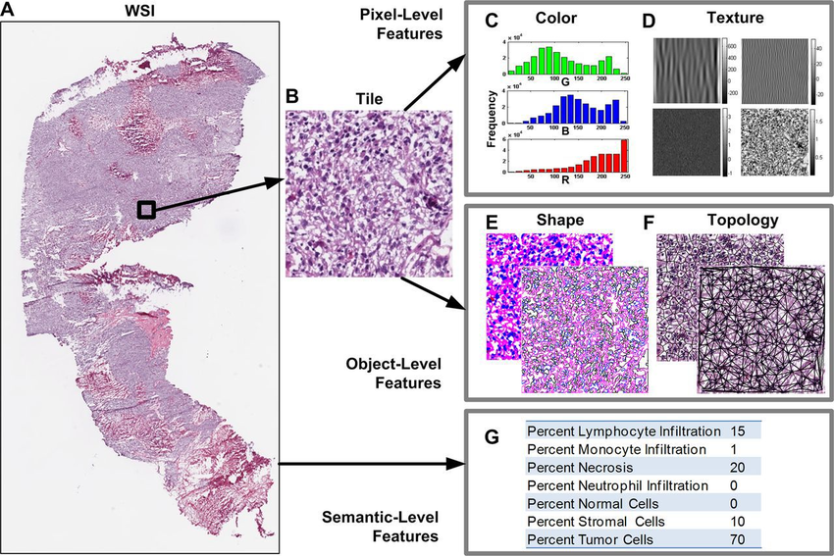
Biomedical Image Processing

Slide 21
Images and Human Perception
Position, Size, Inter-relationship and other information of many objects can be carried out by a single picture
An image can be interpreted differently by different people, because a lot of information resides in a single image
Human perception varies if the picture quality is not good
Due to today’s computer advent, images can be well interpreted even if the picture quality is poor
Pictorial information perceived by human being is always highest among the other information

Slide 22
Images – Light Reflection/Refraction
Images are the visual representation of an object or scene which is generated on the basis of light absorption and reflection theory
When light is incident on an object, some amount of light is absorbed and the remaining is reflected, which form images
Reflected light is received/collected on a screen (or on a photographic plate) or may be received by human eye
Moving image or a scene, is a series of images projected rapidly; Human eye has the capability see it as an integrated information

Slide 23
Images Types based on acquisition
Following are the different types of images based on acquisition
Graphical Images
Optical Images
Perceptual Images
Mental Images

Slide 24
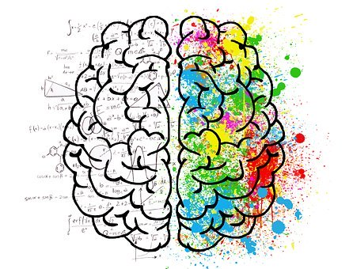
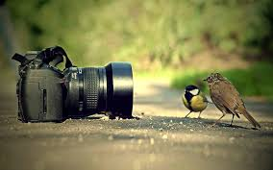
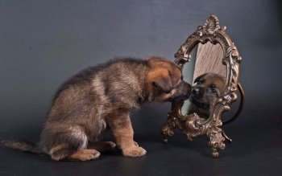
Images Types…
Graphical Images
Created using lines or certain shapes with the help of commands/mathematical statements by any suitable programming language(s)
Computer Graphics deals with the graphical images (their character and other activities)
Optical Images
Are produced using lens or mirror system
Image is formed by collecting the reflected, refracted or diffracted light waves
Real Image – Image captured by camera
Virtual Image – Mirror image

Slide 25
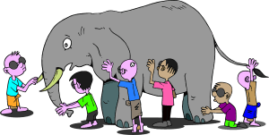
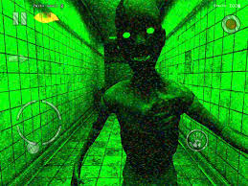
Images Types …
Perceptual Images
Perceived by Human beings
These images may be true or result of illustrations or may be assumptions of some images at far
These figures or images are perceived by the brain and interpreted accordingly
The perception does not change until the attention is focused to different regions or objects
The meaningful perception remains as static image
Mental Image
This kind of image is visualized by the human brain even after some time
These images are stored in the cells of brain and cognitive nature of brain recognizes (or) sees the mental image
Images perceived, created or stored (dream images) by the neural systems of brain are called Neural Images
These images help us in keeping thoughts, information images and objects in our mind

Slide 26

Images Types….
Digital Image
Digitally Captured (by cameras) or scanned (by scanners)
An image can be represented as two dimensional data which consists of pixel
A pixel is a picture element or picture cell which carries intensity or gray scale integers
Mathematically an image is a two dimensional (2D) function of f(x,y)
where x,y are the co-ordinate values in spatial plane and
the magnitude of f(x,y) is the intensity value of pixel at (x,y)

Slide 27
Image Attributes
Image Resolution
IR = Total no. of pixels present in Row x Total no. of pixels present in column
Image Depth
Image depth determine number of colors, an image can have
Image Depth = No. of Colors
2¹ = 2 Colors, 2² = 4 Colors, ….. 2⁸ = 256 Colors
Color Spaces and Channels
Different color spaces are available in the world of DIP
An image can have its color/ values in the following eg.. Forms
RGB (Red, Green, Blue) intensity
CMYK (Cyan, Magenta, Yellow, Key (Block)
HSV (Hue – Saturation – Values)
HSL (Hue – Saturation – Lightness)
Gray Scale
Binary Images
Each value in the color space is called as color channel
For eg. RGB – Red Channel, Green Channel and Blue Channel
The colors in the image are derived by the mixture of colors in each color channel

Slide 28

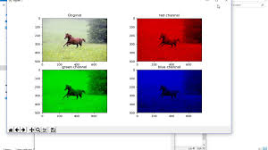
Common Color spaces
Grayscale (Monochrome)
Simplest color spaces both in terms of understanding (handling) and storing on a computer
Each pixel value in gray scale image is a single value between 0 & 255
0 represents black, 255 represents white
255 is not fixed, depends on color depth
RGB (Red, Green and Blue)
Most commonly used in DIP
Each pixel is a combination of three values, each representing a color in Red, Green and Blue channels
In RGB space
White – (255,255,255)
Black – (0,0,0)
Red – (255,0,0)
Green – (0,255,0)
Blue – (0,0,255)
The color depth of RGB is 8 bit (m x n x 3)

Slide 29
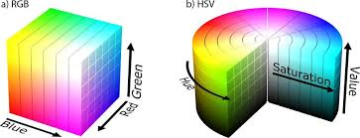
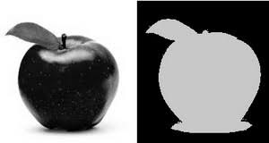
Common Color Spaces….
HSV (Hue – Saturation – Value) : Color – Density – Value
A cylindrical co-ordinate system
RGB values onto a cylinder
RGB space does not have clear idea about the color progression
HSV handles it perfectly
Fix the hue, then generate different shades of the hue by just varying values and saturation
Binary Image (Bi-level or two-level)
A binary image consists of exactly two colors usually black and white
Each pixel is stored as a single bit ‘0’ or ‘1’
Binary image is created from gray scale image that uses ‘0’ for pixels with gray levels below the threshold and ‘1’ for other pixels
Useful for CV (Computer-Vision) applications, where edges, boundaries or outlines are required

Slide 30
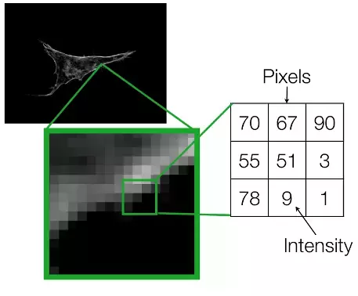
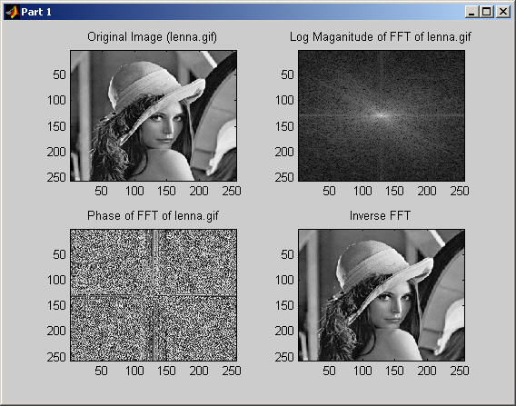
Image Domains
Spatial Domain
Procedures that operate directly on pixels
Methods: Darkening, lightening, compressed to disks, High contrast, Emphasize shadows
Frequency Domain
Deals with the rate of which the pixel values are changing in spatial
i.e. frequency pattern of image pixels

Slide 31
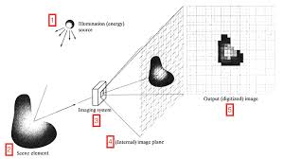
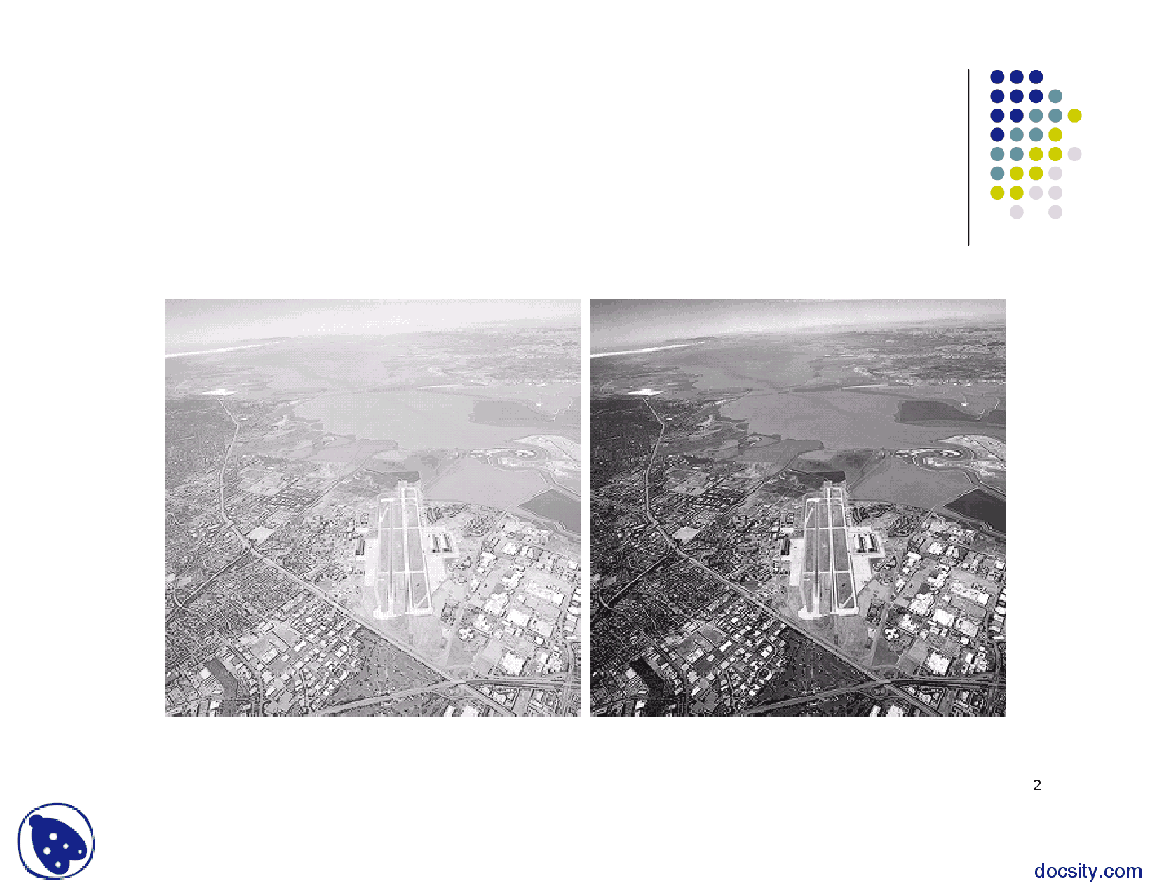
Main components of DIP
Main components of DIP
Image Acquisition – Deals with capturing images or samples
Image enhancements – Deals with the improvement of quality of images

Slide 32
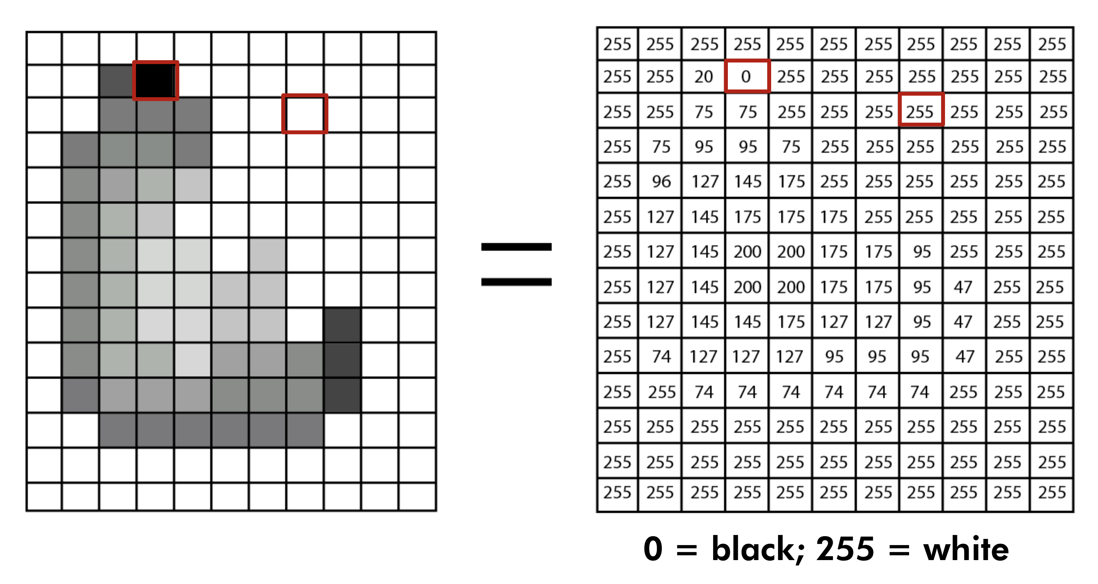
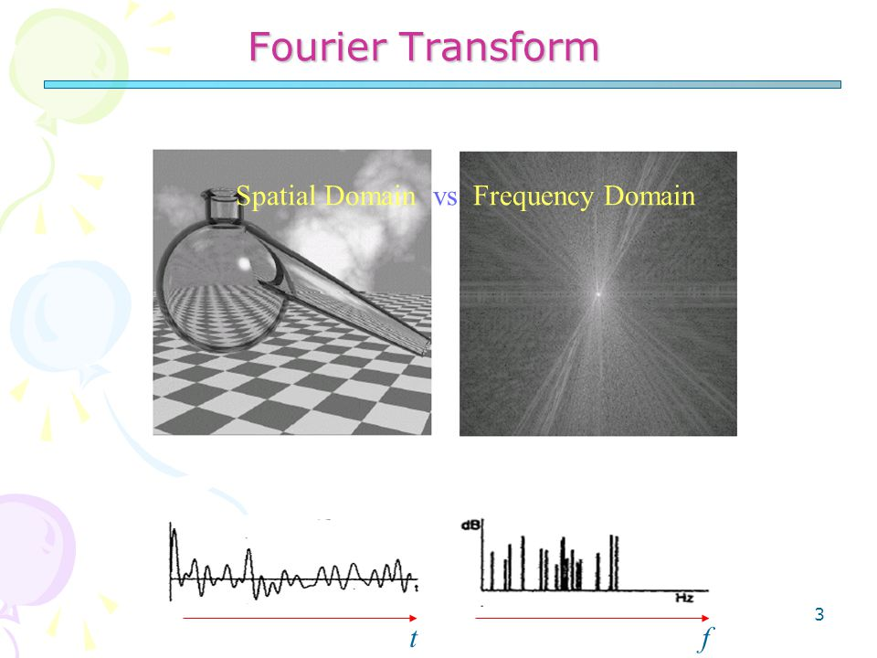
Main components of DIP
Main components of DIP
Image Representation – Deals with different ways in which image can be represented mathematically, graphically and statistically
Image Transformation – It is used to transform from one domain into another domain (Eg. Spatial domain to Frequency Domain)

Slide 33

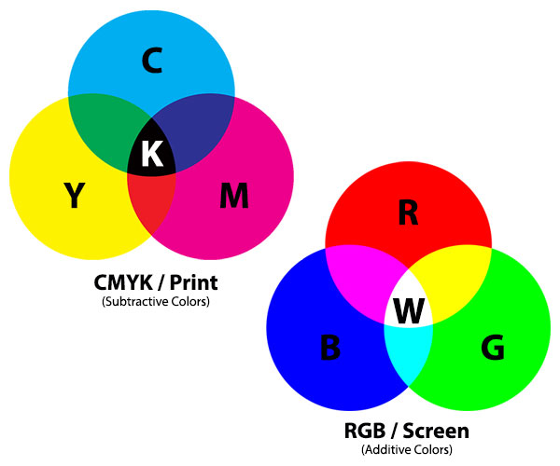
Image Restoration - Deals with the analysis and modeling of different types of noise, mixed with the image
Color Image Processing – Various color spaces and formats are covered in it

Slide 34
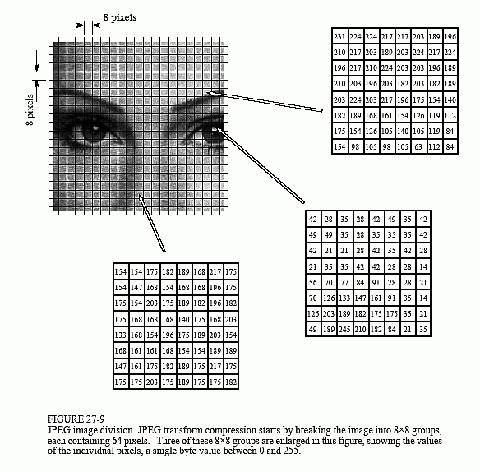
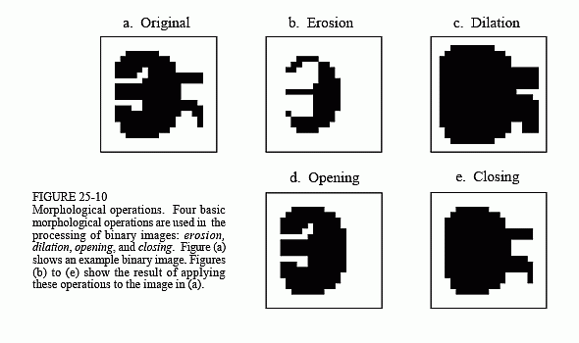
Main Components of DIP…
Main components of DIP
Image Compression - Used to reduce redundancy without any significant change in the inherent content of the image
Morphological Image processing - Used to represent or convert into suitable forms so that the edges can be easily recovered

Slide 35
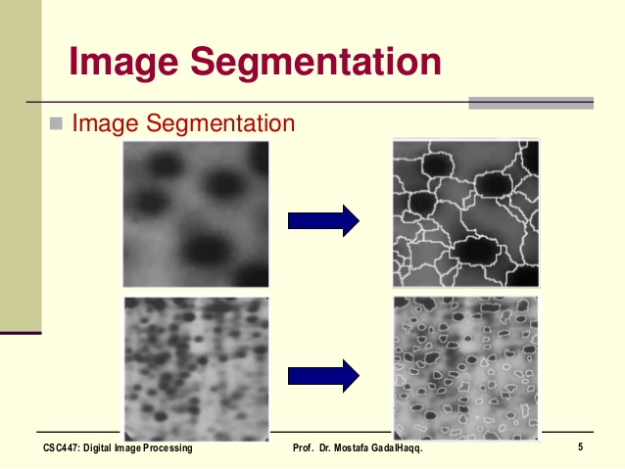
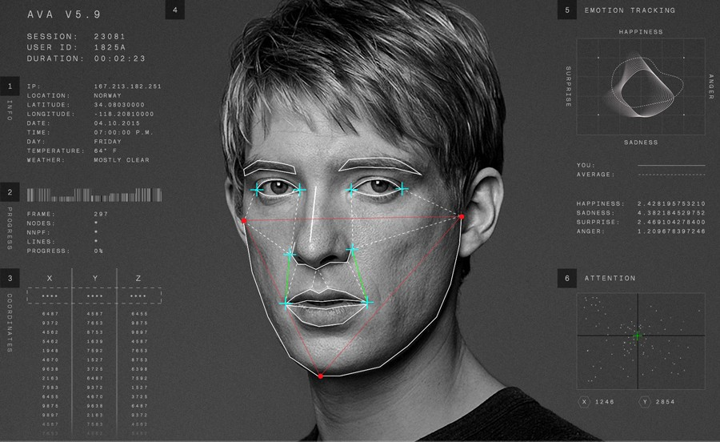
Main Components of DIP…
Main components of DIP
Image Segmentation - The selected ROI (Region of Interest) and various boundaries can be extracted
Object Recognition - Deals pattern and Matching

Slide 36
Basic Architecture of DIP
Object
Image acquisition
Sampling and Quantization
Digital Storage System
Image Transformation
Image Enhancement
Image Restoration
Image Segmentation
Image Compression
Object Recognition
Digital Computer
Post Processing
Display

